Slide 1
ISP Final Term Project
Logan Mashchak, Ryan DeBoer, Connor Taylor

Slide 2
Project Layout
Our project is a degree tracker for the UA Computer Science department for Computer Science BS majors (systems and management tracks) as well as the CS minor.
The systems creates and saves student accounts to allow them to track their degree program. It first gets the student’s first and last name, degree program, and current classes they have taken. From there, they can view the classes they have taken, what classes they still need to take, and add classes to their account that they have taken.
It also will inform the user how many elective credits they still need to take.

Slide 3
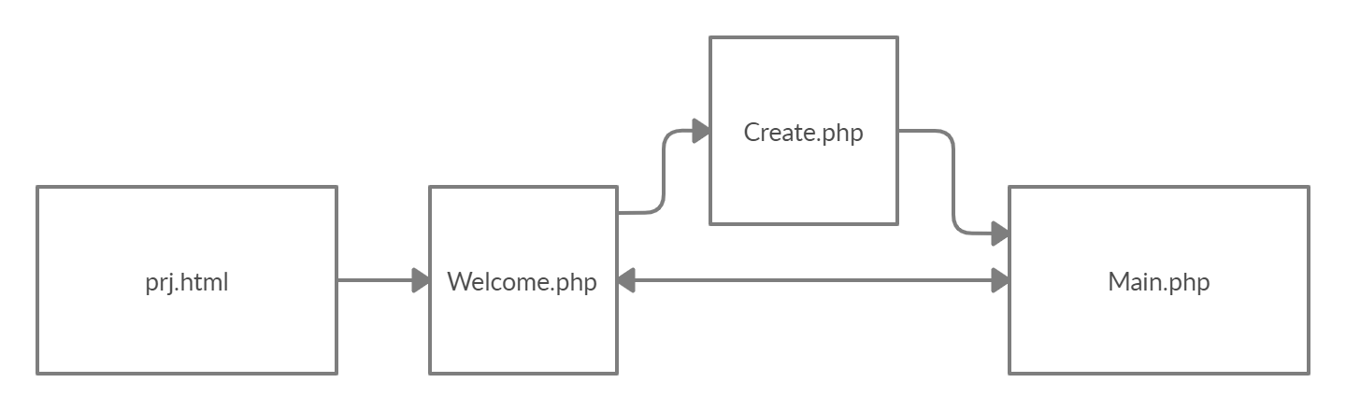
System Design

Slide 4
System Design (cont.)
Our project consists of three PHP files (A welcome page, a create page, and a main page) and an HTML file that starts the program (prj.html).
Welcome Page
◦Asks the user for their ID and whether they would like to log in or setup an account
Create Page
◦If creating a new account, it asks the user for their first and last name, which major or minor they are doing, and what classes they have taken based on their selection of one of the majors or the minor
Main Page
◦Once an account is created or an old account is accessed, they are taken to the main page which enables the user to either view the classes they have taken already, the ones they still need to take, or add to their tracker classes they have taken since the creation of the account.

Slide 5
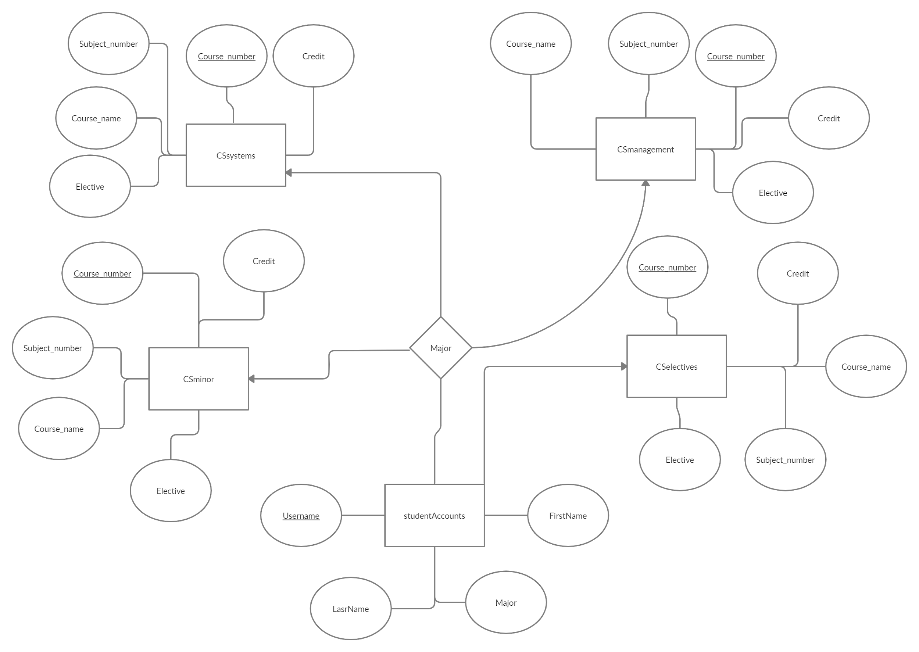
Entity-Relationship Diagram of SQL implementation

Slide 6
Implementation Tools
Our program uses the following languages:
HTML
CSS
PHP
SQL
We also utilize phpMyAdmin with MySQL and WAMP to save the course tables and student account tables.

Slide 7
Issues Encountered and Conclusions
Issues encountered
Webpages with coinciding buttons encountered issues with stored variables since variables are wiped after a button is pressed again. It made it difficult to pass variables to functions that are triggered by separate events. We found a solution to this by using _SESSION to store variables, we were able to save data across the different pages.
Conclusions
Overall, the project was a great learning experience and helped to develop our skills as for the front-end. Given more time, we would have expanded the project to a larger department with more options and configurability.
SQL’s versatility with PHP gave us alot of options for pulling, ineserting, and displaying the information inputted by the user

